Slide 1
Plant Disease Detection using transfer learning

Slide 2
PlantVillage Dataset
Different categories
In total 38 which contains:
14 crop species, 17 fundal diseases, 4 bacterial diseases, 2 molds (oomycete) diseases, 2 viral diseases, and 1 disease caused by a mite. 12 crop species also have images of healthy leaves that are not visibly affected by a disease.
More than 50K images
This dataset contains an open access repository of images on plant health to enable the development of mobile disease diagnostics.

Slide 3
The task is to build a model capable to recognize if a leaf has a disease or not
Let’s start with the first set of slides

Slide 4
The higher demand for total, safe and diverse foods to support the booming global population.

Slide 5

Past approach
Support Vector Machines
K-means clustering
Neural Network
All of them are now not currently used for imagine recognition tasks

Slide 6
Current approaches - state of the art CNN models
AlexNet
VGG16
Inception V3
Inception resnet V2

Slide 7
Our approach
Using simple CNN model
Adding complexity to the simple model
Adding convolutional layer to the simpler model
Let the parameters of the simpler model being untrainable
Using the Inception resnet v2 for transfer learning letting the parameters of this model being untrainable
Fine - tuning the last 80 layers of the Inception resnet V2

Slide 8
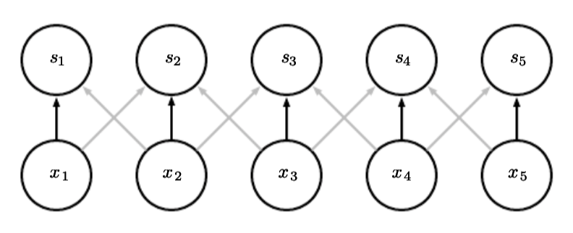
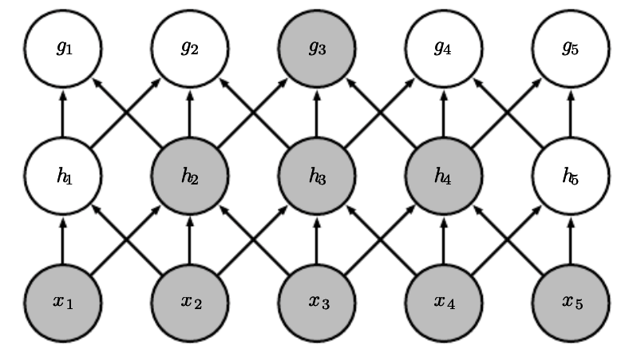
About CNN
Sparse interaction
Parameter sharing
Equivariant representation

Slide 9
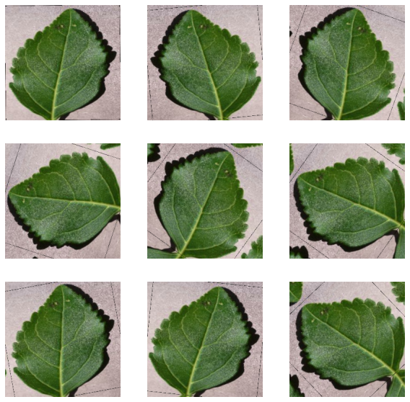
Preprocessing
Augmentation
Augmenting images by randomly flipping and rotating them.

Slide 10
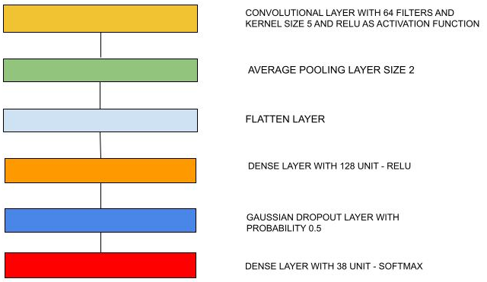
Simple CNN
Train accuracy of 54%
Validation accuracy of 43%

Slide 11
Improvement of simple CNN
Removing from the model those layers
Keeping these 2 layers trained on the previous epochs, setting the parameters to be untrainable
Using this new model with 2 layers to build another model consisting of a model like the previous one plus the new model

Slide 12
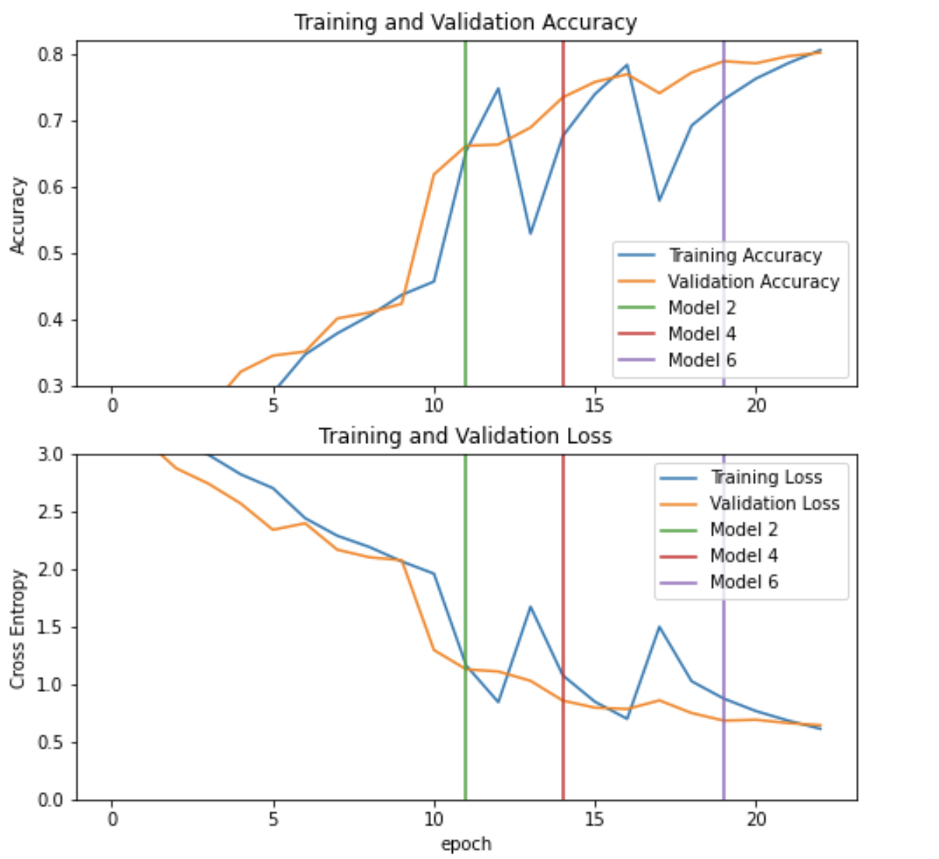
Performance of the final model

Slide 13
Transfer learning - Inception resnet V2
Trained on ImageNet
We used the trained version
We add a global average pooling layer
We add a dropout layer with probability 0.2
We add the prediction layer

Slide 14
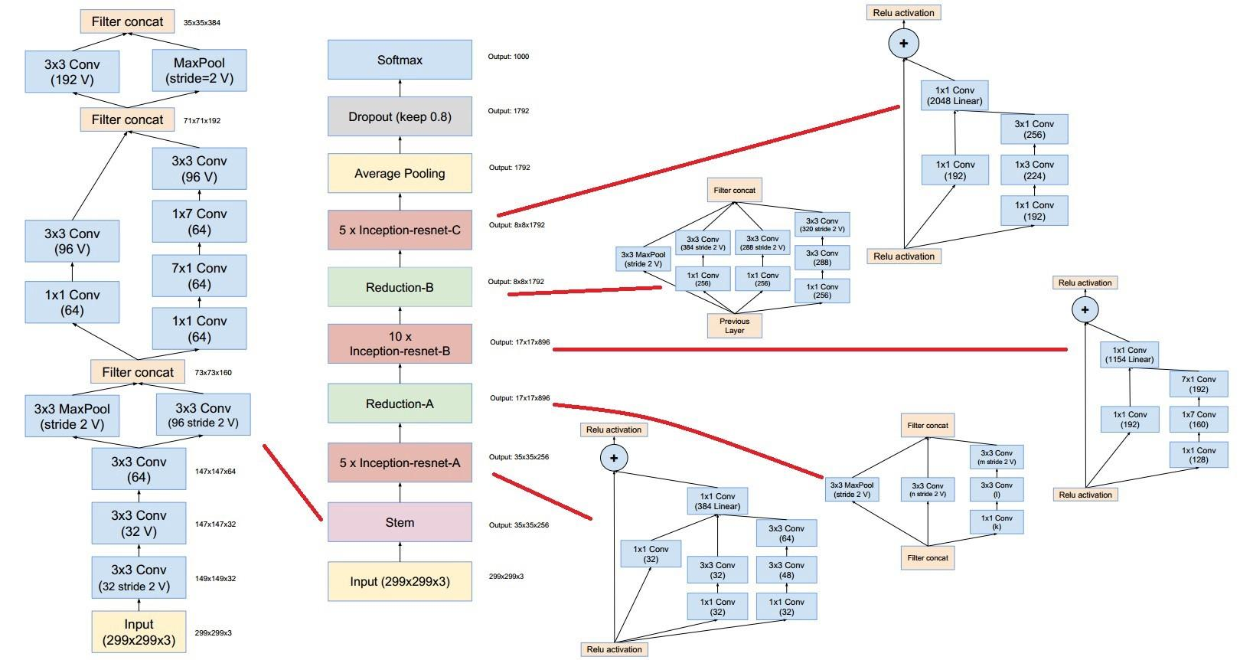

Slide 15
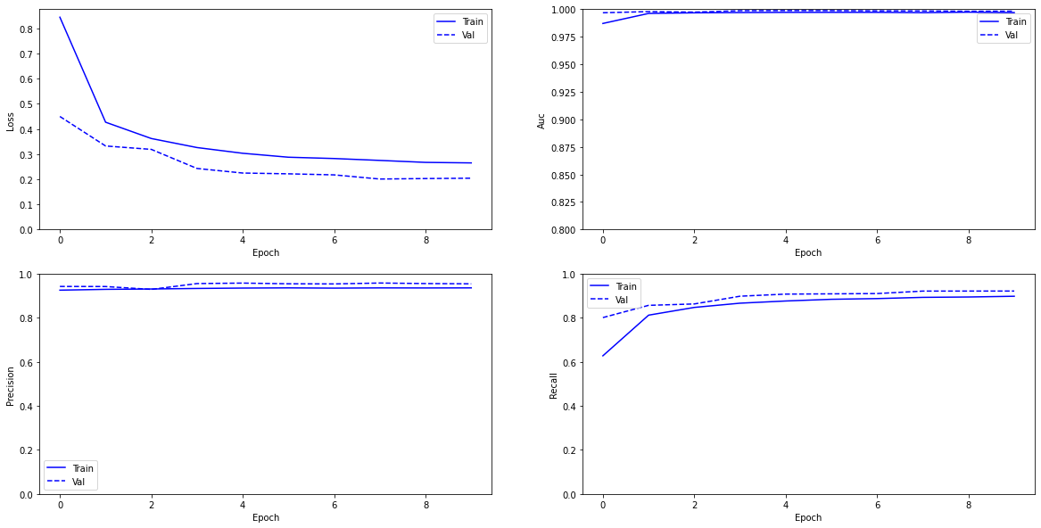
Performance of TL model

Slide 16
Fine - Tuning
Letting the parameters of the last 80 layers being trainable
Training the new model starting from the last epoch, for 15 epochs

Slide 17
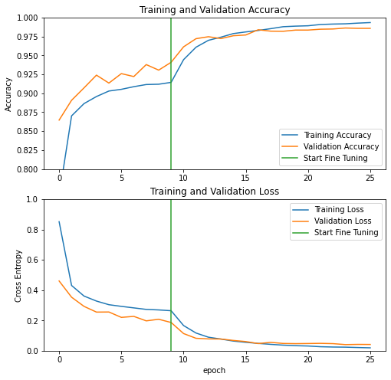
Performance of the fine tuned model

Slide 18
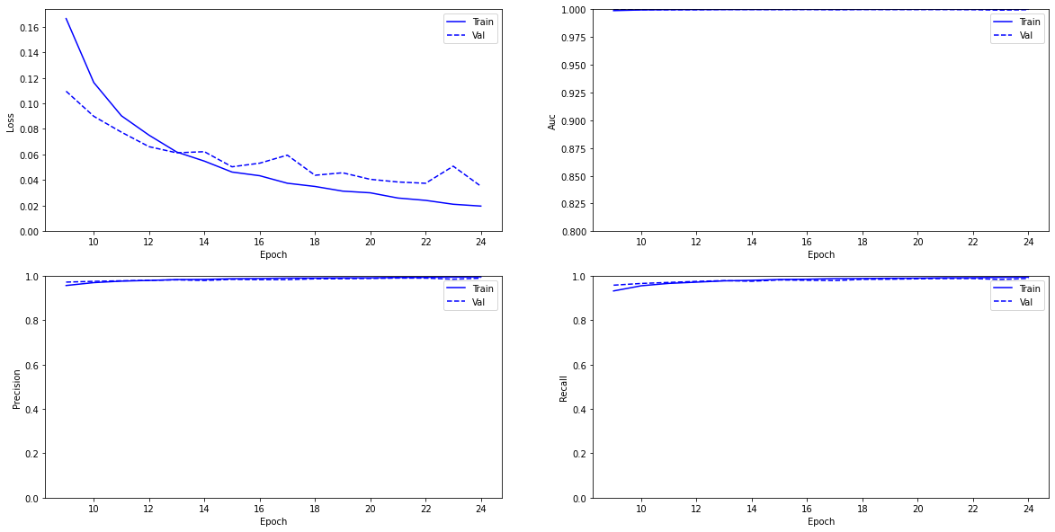
Performance of the fine tuned model

Slide 19
Conclusion
Thank for your attention.

